Slide 1
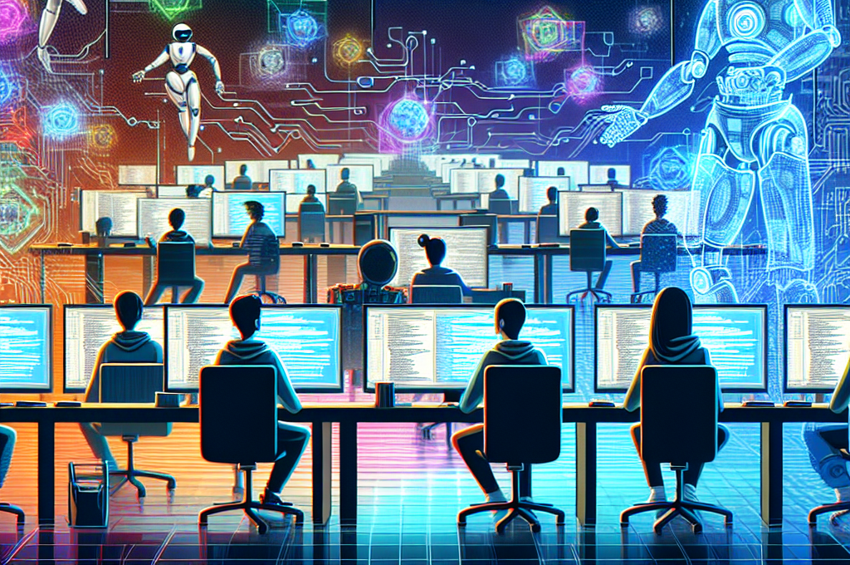
NUS MUFG DELL HumanITy challenge:
Remote Automated Intelligent Network
By MAX EFFORT
Danial, Hasan, Chun Kit, Haziq

Slide 2


Background and Target
Electronic waste is a growing problem worldwide, with tons of discarded electronics ending up in landfills each year. However, many of these devices contain components that can still be salvaged and repurposed creatively to reduce waste and promote sustainability.
Repurpose e-waste, extend the life of electronics, and help Singapore move towards a sustainable future.

Slide 3
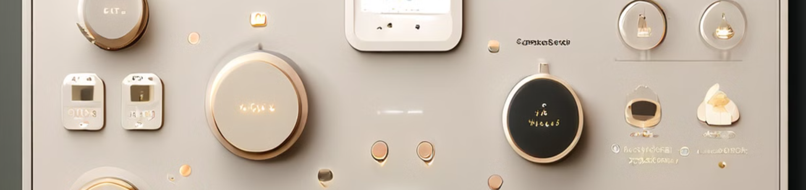
What is R.A.I.N?
R.A.I.N repurposes working components from e-waste and integrates predictive maintenance for household electronics to create a fully comprehensive and modular home-based IoT system.
The system's core is an Espressif ESP32 S3 board, which acts as the brain and cloud link via RainMaker by Espressif. The system functions as a smart lighting system, smart cooling system, alert system, provides temporary backup lighting, and performs predictive maintenance for home electronics.

Slide 4
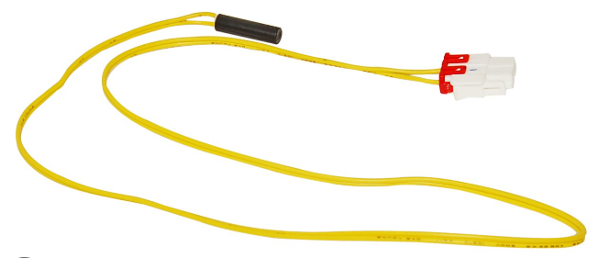

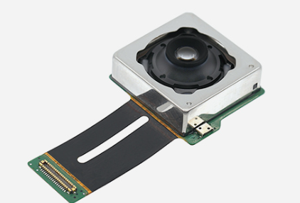
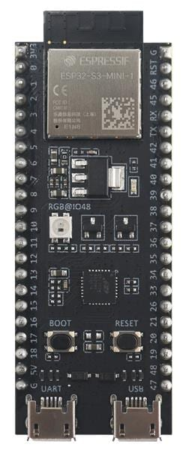
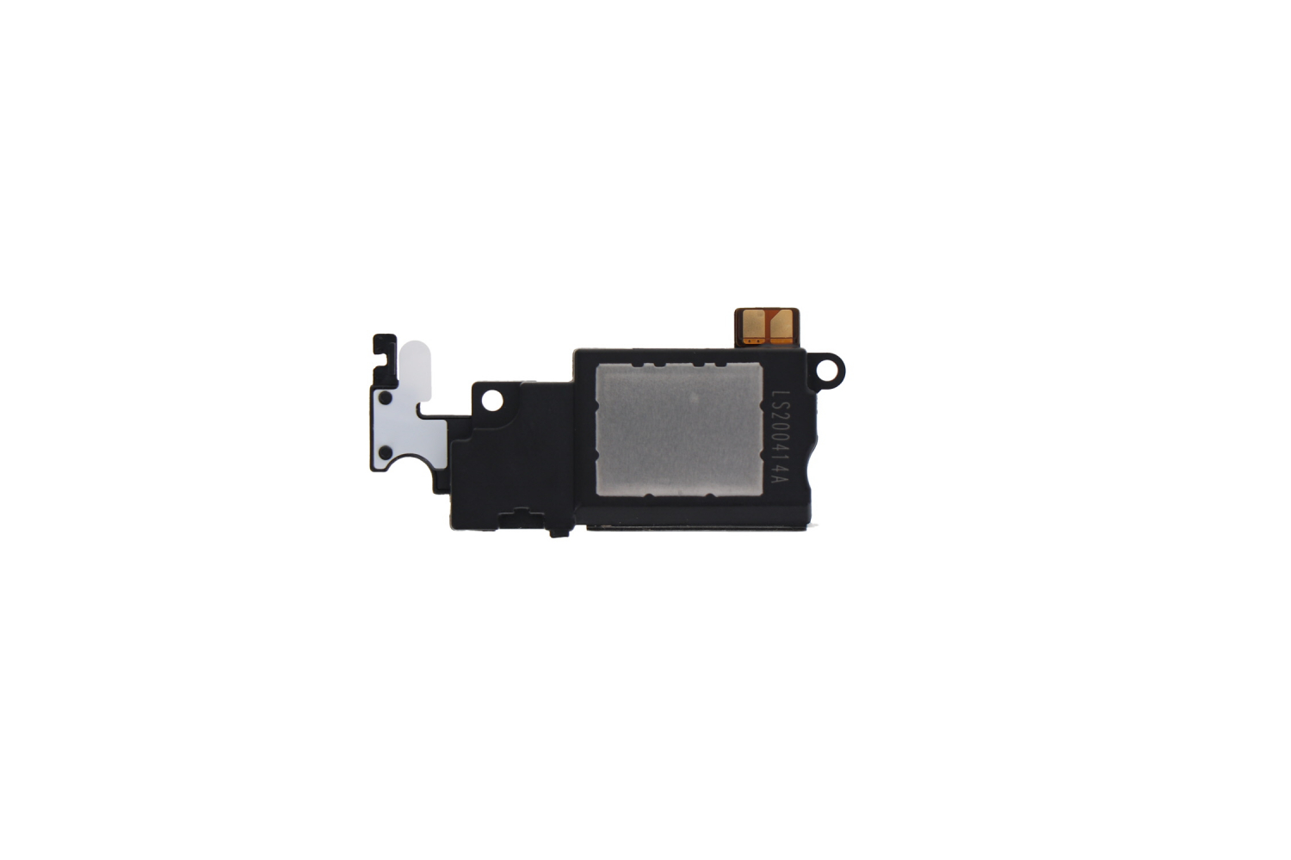
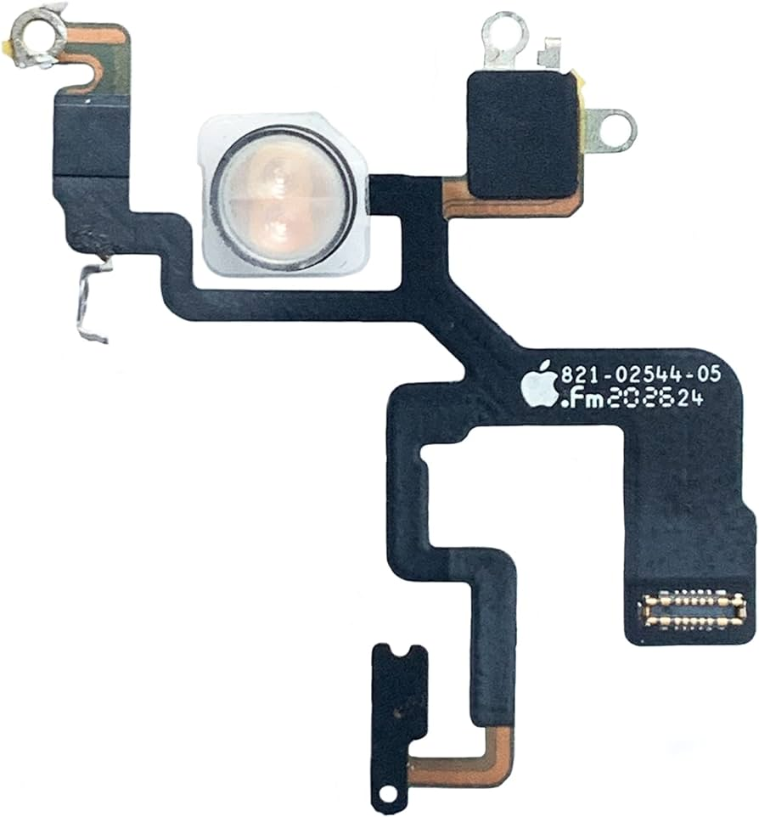
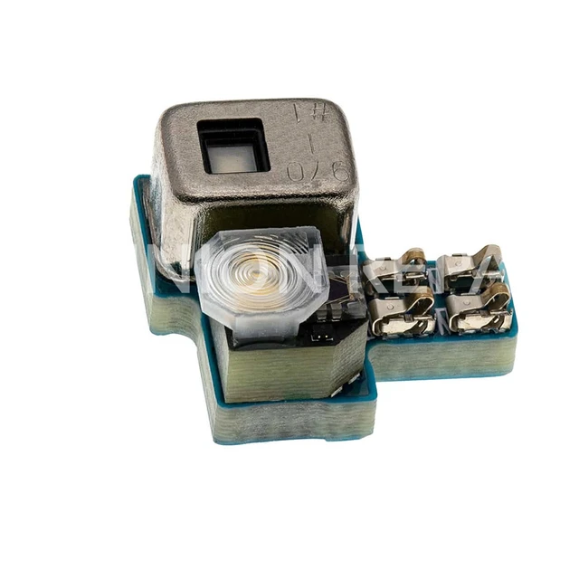
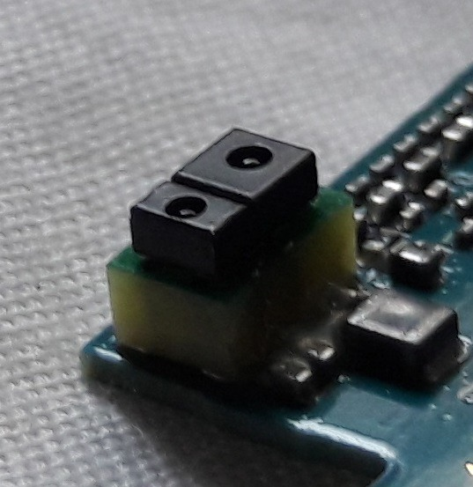

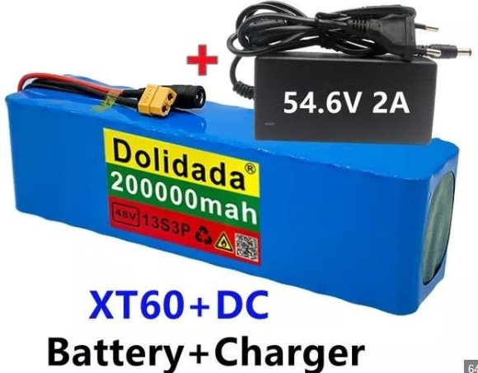
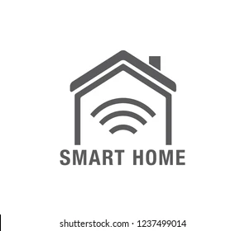
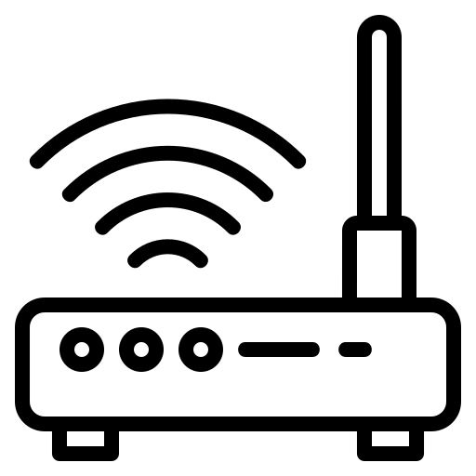
Refrigerator Temperature Sensor
Phone camera
ESP32 - S3
Phone speaker
Phone Proximity and Ambience Light sensor
Phone LED Light
PMD Battery

Slide 5
Source of Parts
Temperature Sensor
Rechargeable Batteries
LEDs
Speakers
Sourced from discarded refrigerators and air conditioning units
Repurposed from personal mobility devices (PMDs) like electric scooters
Salvaged from
old mobile phones
Sourced from discarded mobile phones or standalone speakers
Camera
Light Sensor
Proximity/Motion Sensor
Repurposed from old mobile phones
Salvaged from
old mobile phones
Sourced from discarded mobile phones

Slide 6

System Components and Functionality
Core Component: ESP32 Board
Cloud Connectivity
The ESP32 board enables the R.A.I.N. system to connect to the cloud through RainMaker, a platform by Espressif and ThingSpeak. This allows for remote monitoring, control, and data analysis, making the system more versatile and accessible.
The ESP32 board is the R.A.I.N. system’s central hub, with built-in WiFi and Bluetooth capabilities. It connects the various sensors and devices to the cloud via RainMaker and ThingsSpeak, allowing seamless integration and control.

Slide 7
System Components and Functionality
Mobile App Control
Energy tracking
Users can control and monitor the R.A.I.N. system through the dedicated ESP32 app, which provides a user-friendly interface for managing the various smart home functions.
Participating users can opt to have R.A.I.N tag onto the home’s electricity meter and be placed among other users in a “neighborhood leaderboard”, users who save more will rank higher. Top 3 will receive rewards.

Slide 8
System Components and Functionality
Predictive Maintenance
These data will be used by TensorFlow, a machine learning platform, to perform predictive maintenance: - Sensor Data
- Operational Data (Usage hours, Cycle counts)
- Error logs

Slide 9
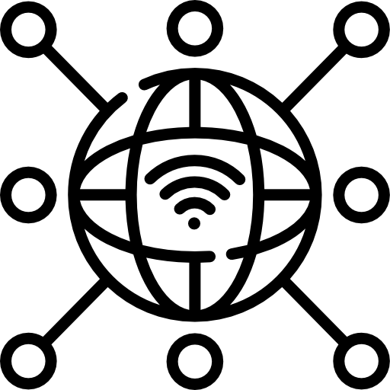
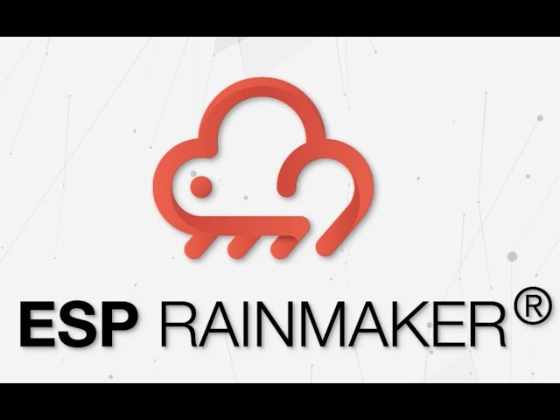

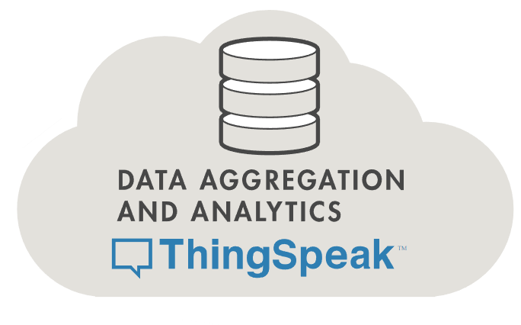


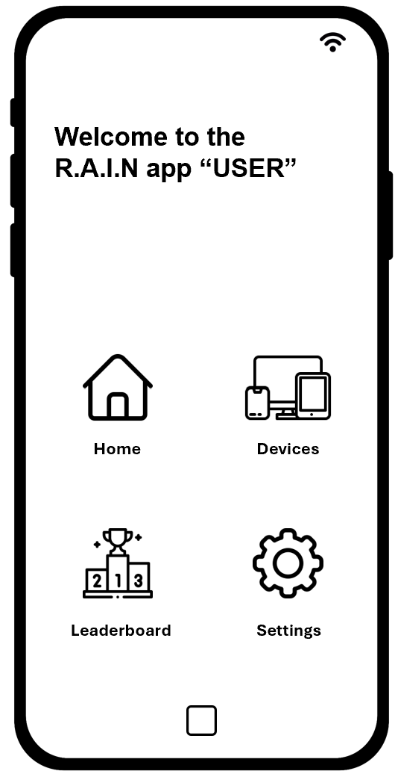
RainMaker App
R.A.I.N App

Slide 10
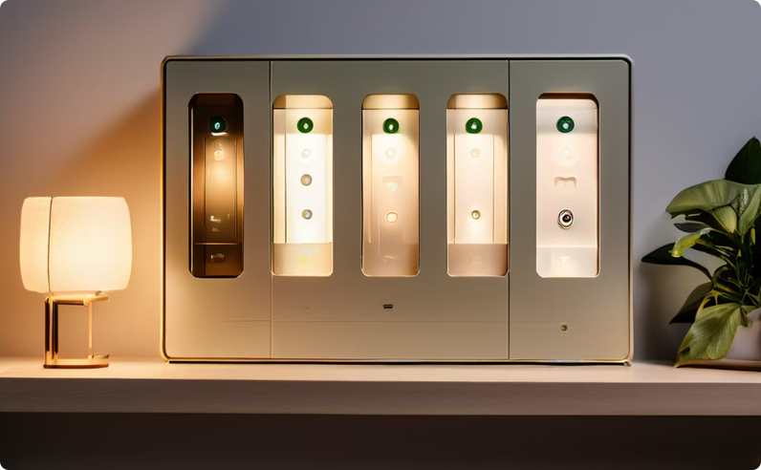
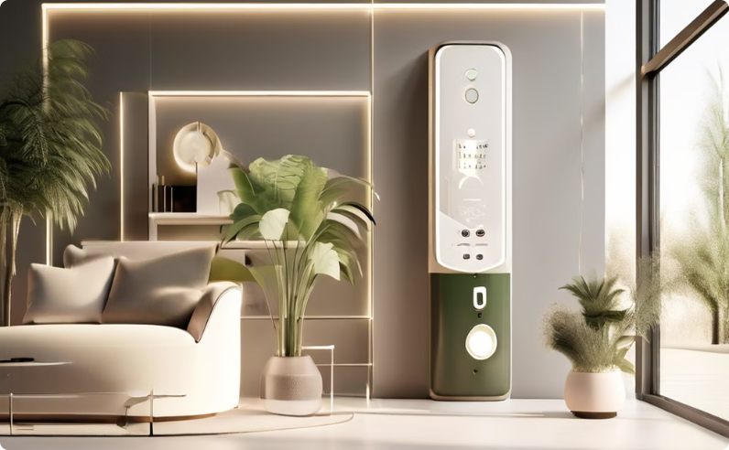
Smart Lighting and Cooling Systems
Smart Lighting System
Smart Cooling System
Uses LEDs and light sensors from mobile phones. Auto-adjusts brightness based on ambient light and user preferences.
Uses temperature sensors from refrigerators and air conditioning units. Automates control of fans or air conditioning systems.

Slide 11



Alert System
Audio Alerts
Security Camera
Proximity/Motion Sensors
Uses speakers for audio alerts, such as doorbell rings, smoke detection, and intrusion warnings.
Uses a camera for security, providing real-time video feeds and motion detection alerts.
Uses proximity/motion sensors to detect intrusions and trigger appropriate responses.

Slide 12
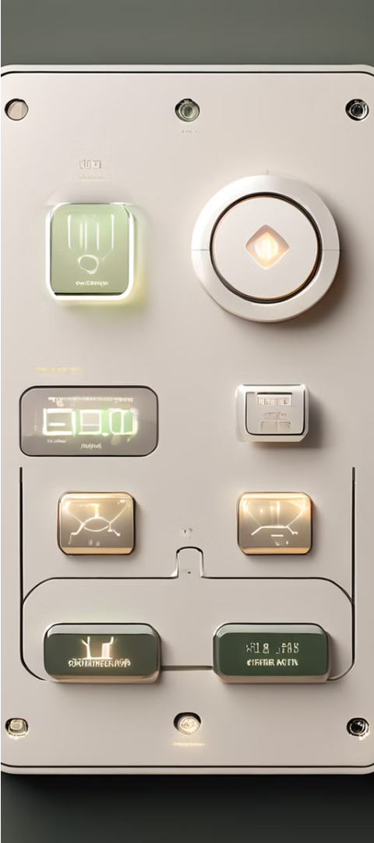
Backup Power and Predictive Maintenance
1
Temporary Backup Power
2
Predictive Maintenance
Uses rechargeable batteries from PMDs to provide essential lighting and power during outages.
Uses TensorFlow for predictive maintenance to extend the lifespan of home electronics.

Slide 13
R.A.I.N app

Slide 14







Welcome to the R.A.I.N app “USER”
Home
Devices
Leaderboard
Settings

Slide 15
Welcome to the R.A.I.N app “USER”
Home
Devices
Leaderboard
Settings

Slide 16





Savers
Leaderboard
Ong family
Zaki family
Lee family

Slide 17
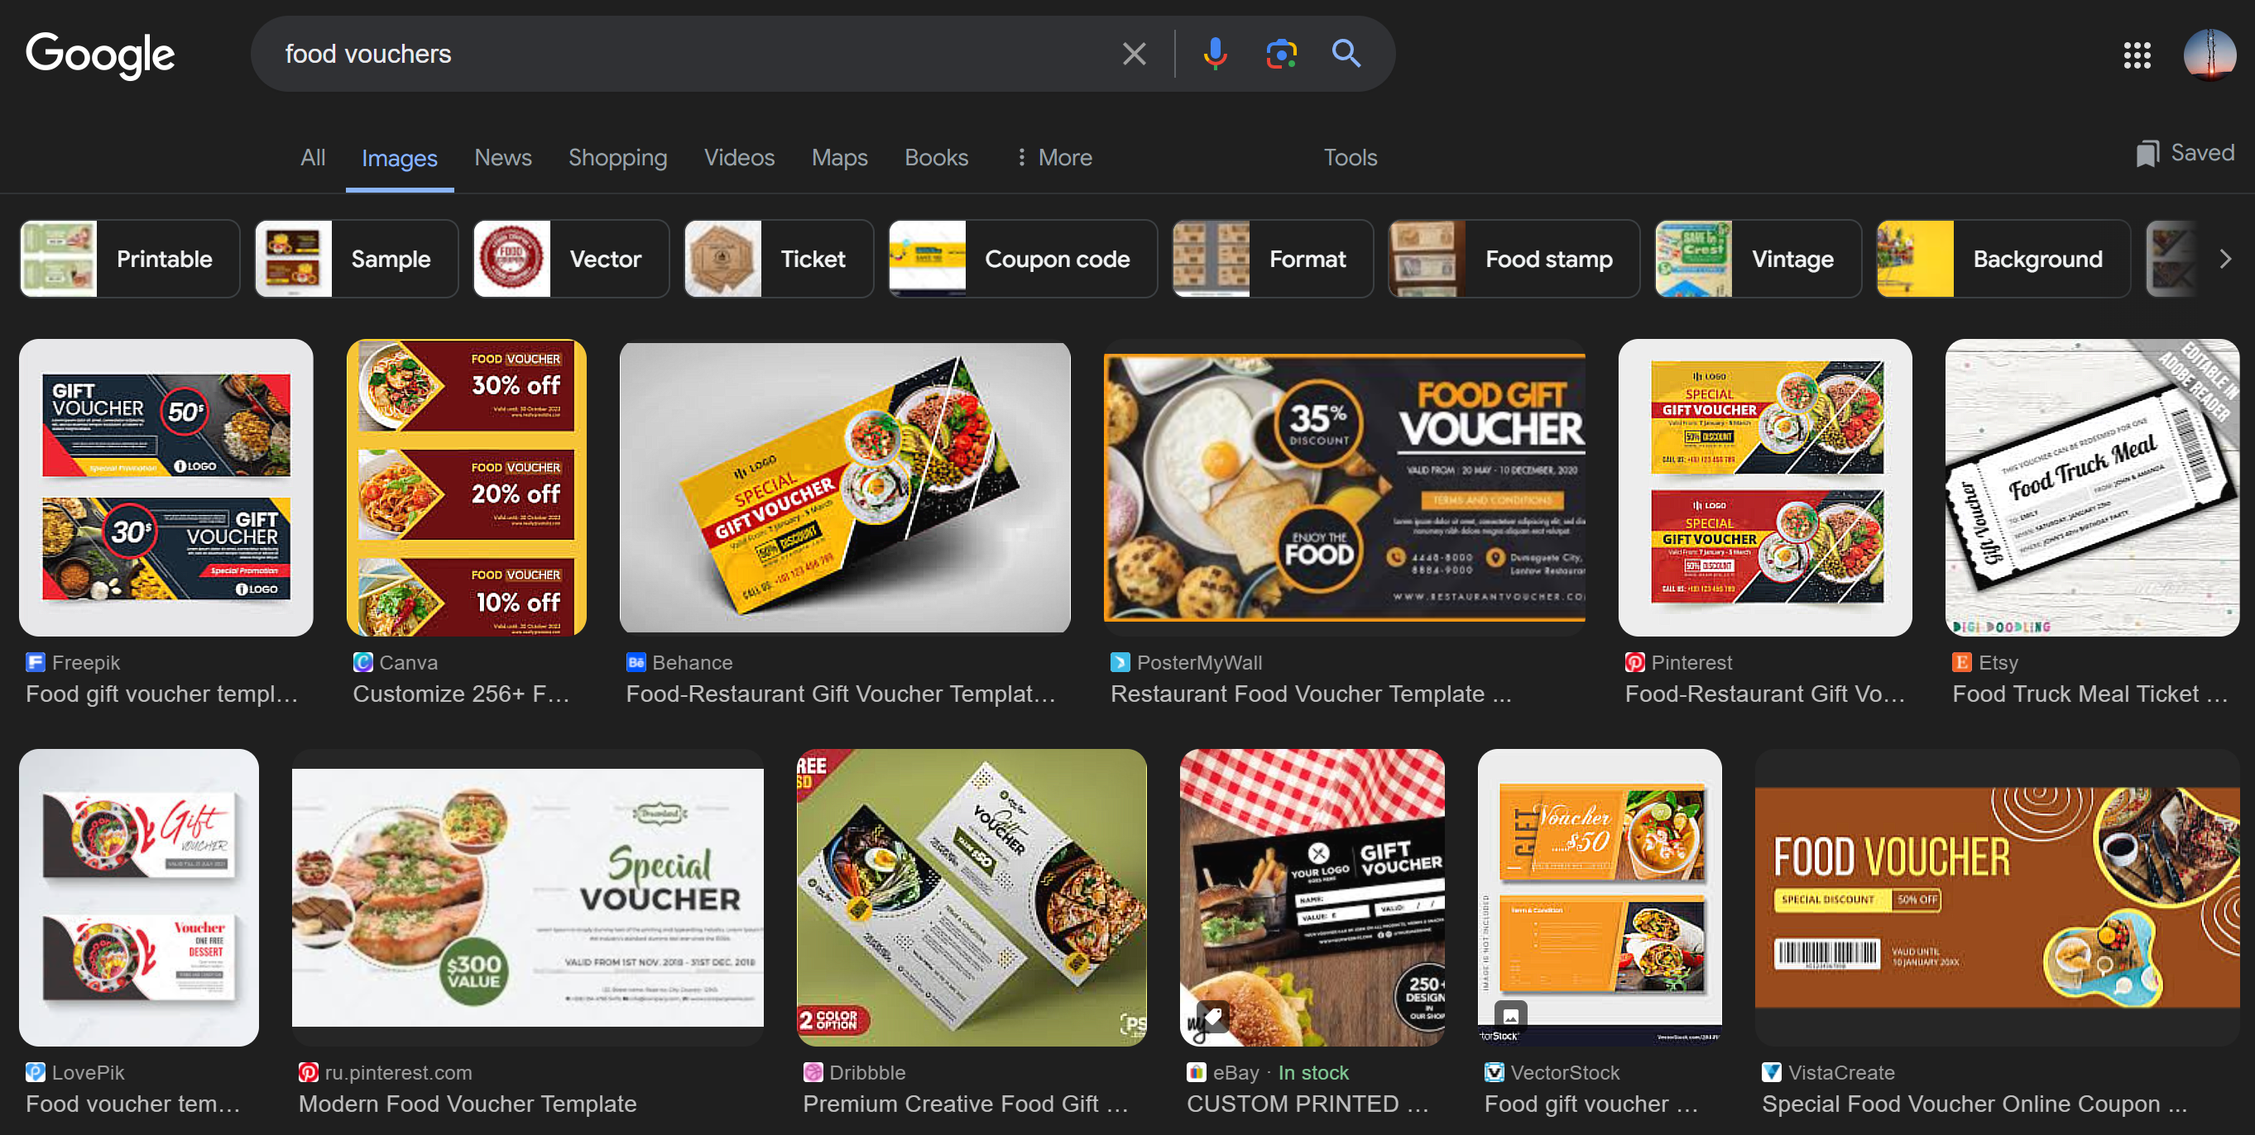

Slide 18
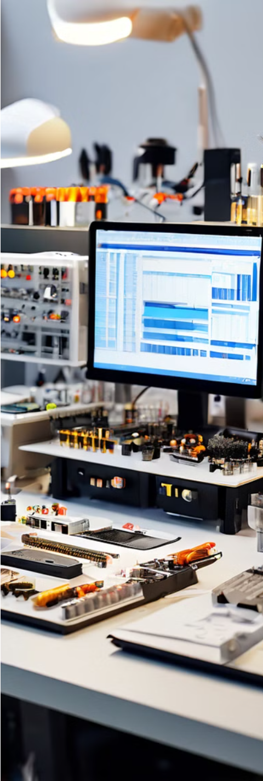
`
Implementation
1
Extract Components
Extract working components from e-waste, test them for functionality, and interface them with the ESP32 board to create the R.A.I.N. system.
2
Develop Firmware
Develop custom firmware to manage the communication between the ESP32 board and the RainMaker cloud service, ensuring seamless integration and control.

Slide 19
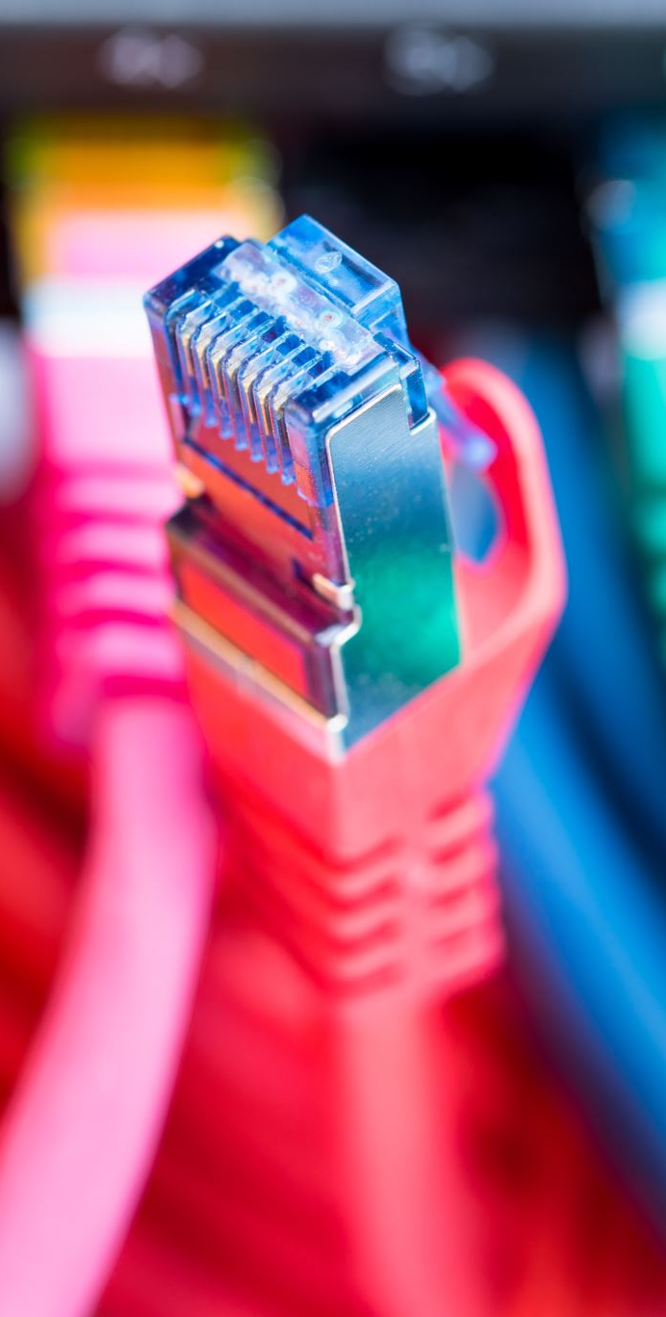
3
Ensure Seamless Operation
Optimize the system's operation and control through the dedicated ESP32 app, providing users with a user-friendly interface to manage the various smart home functions.
4
Collect and rank electricity usage
Collect the participating homeowner’s electricity usage and rank them monthly, the more energy saved the higher ranked they are

Slide 20

Key SDG Contributions

Slide 21
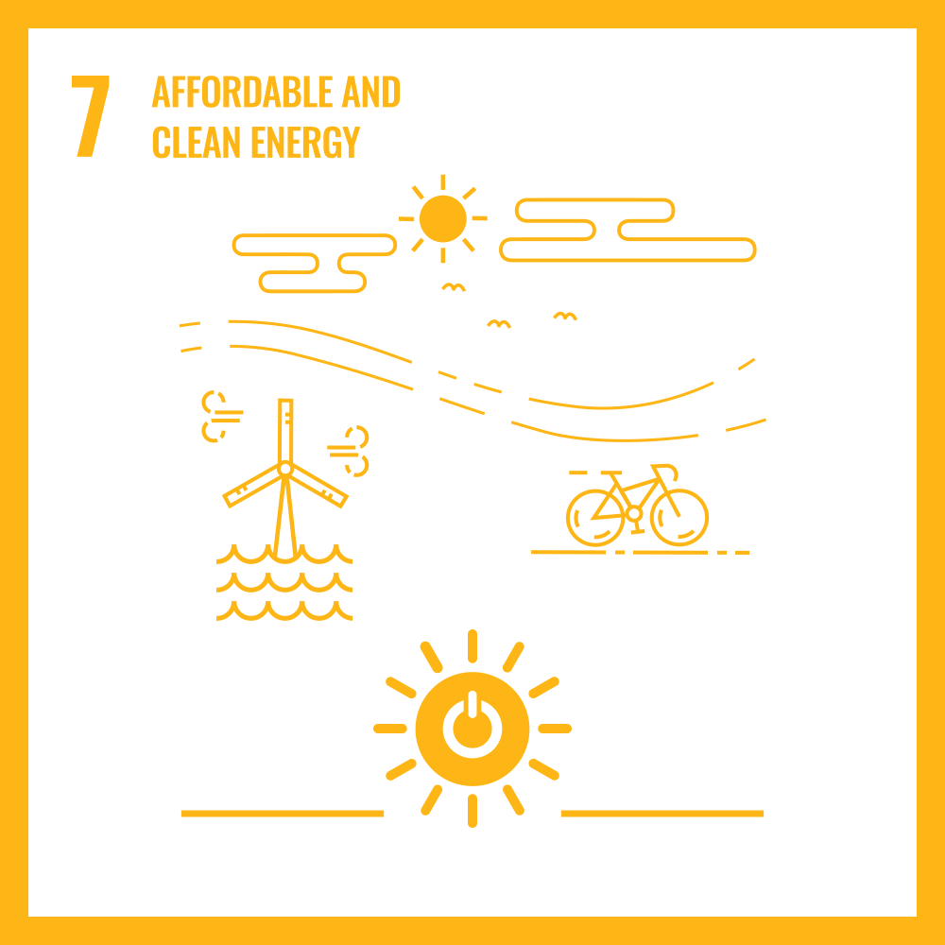
Goal 7 (Affordable & Clean Energy)
7.1
R.A.I.N ensures universal access to affordable, reliable, and modern energy services by monitoring and optimizing energy usage, making energy more accessible and efficient.
7.2
R.A.I.N can integrate with renewable energy systems, increasing the share of renewable energy in the global energy mix and promoting cleaner energy sources.
7.3
R.A.I.N improves energy efficiency through predictive maintenance and power usage tracking, contributing to a global increase in energy efficiency.

Slide 22
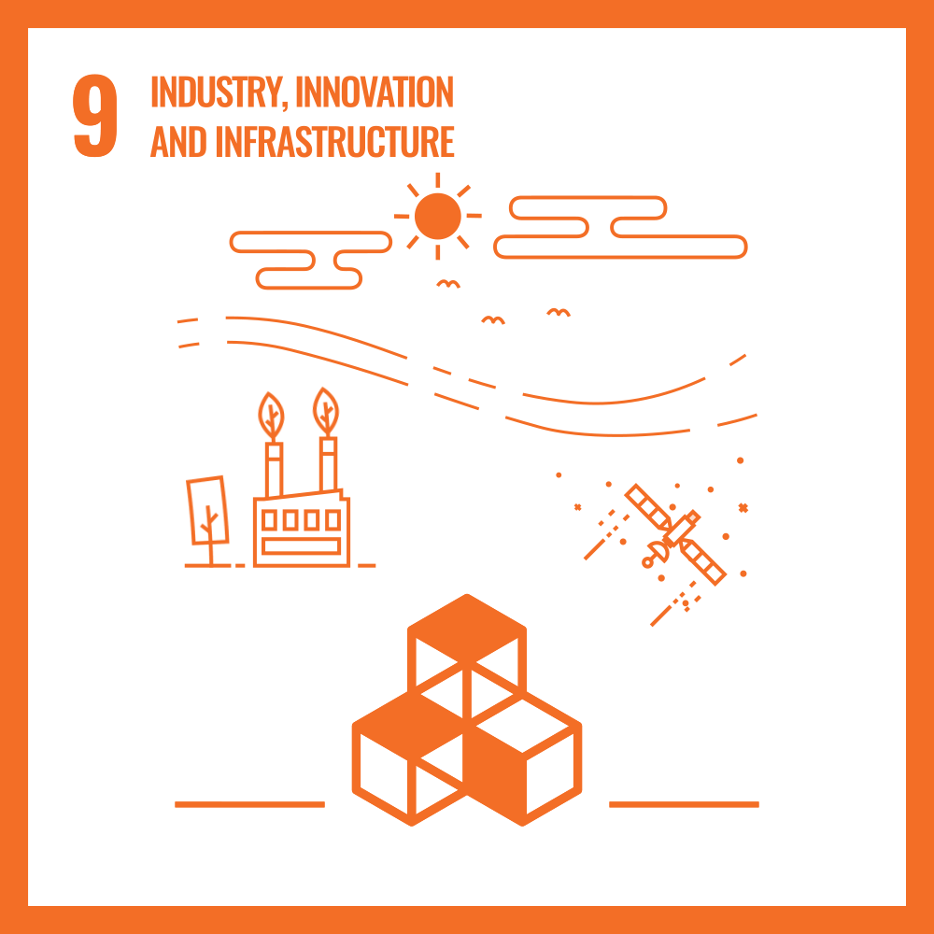
Goal 9 (Industry, Innovation, and Infrastructure)
9.4
R.A.I.N upgrades infrastructure by repurposing e-waste components, promoting sustainable industry practices and enhancing resource-use efficiency.

Slide 23
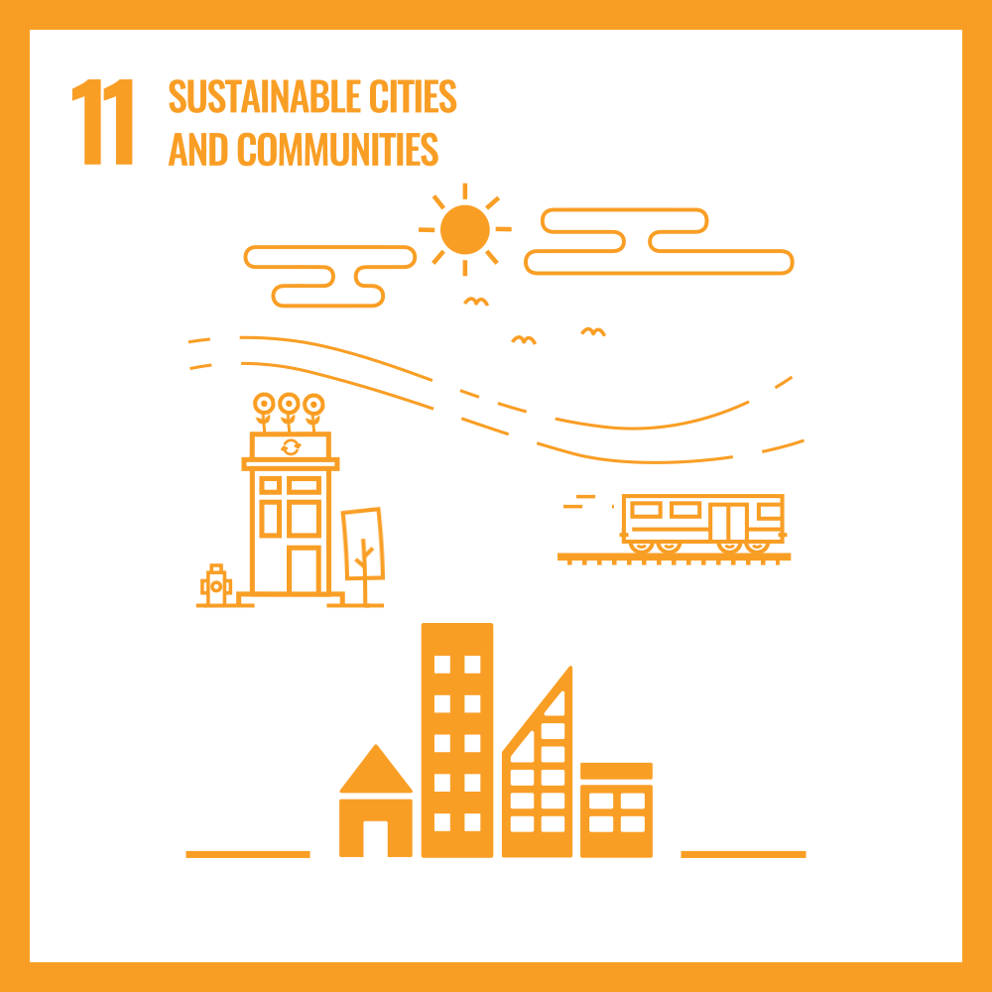
Goal 11 (Sustainable Cities and Communities)
11.6
R.A.I.N reduces the adverse environmental impact of cities by managing electronic waste more efficiently, leading to more sustainable urban living.

Slide 24
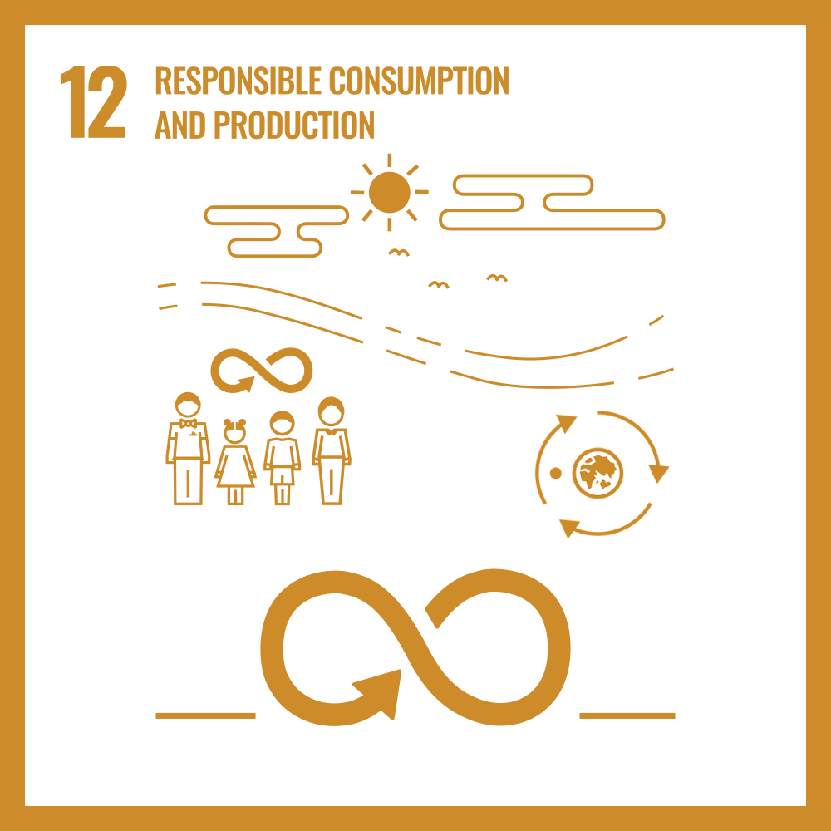
Goal 12 (Responsible Consumption and Production)
12.2
R.A.I.N achieves sustainable management and efficient use of natural resources by encouraging the reuse of electronic components.
R.A.I.N reduces waste generation by repurposing e-waste components for new uses in the IoT system, aligning with waste prevention, reduction, recycling, and reuse.
12.5

Slide 25
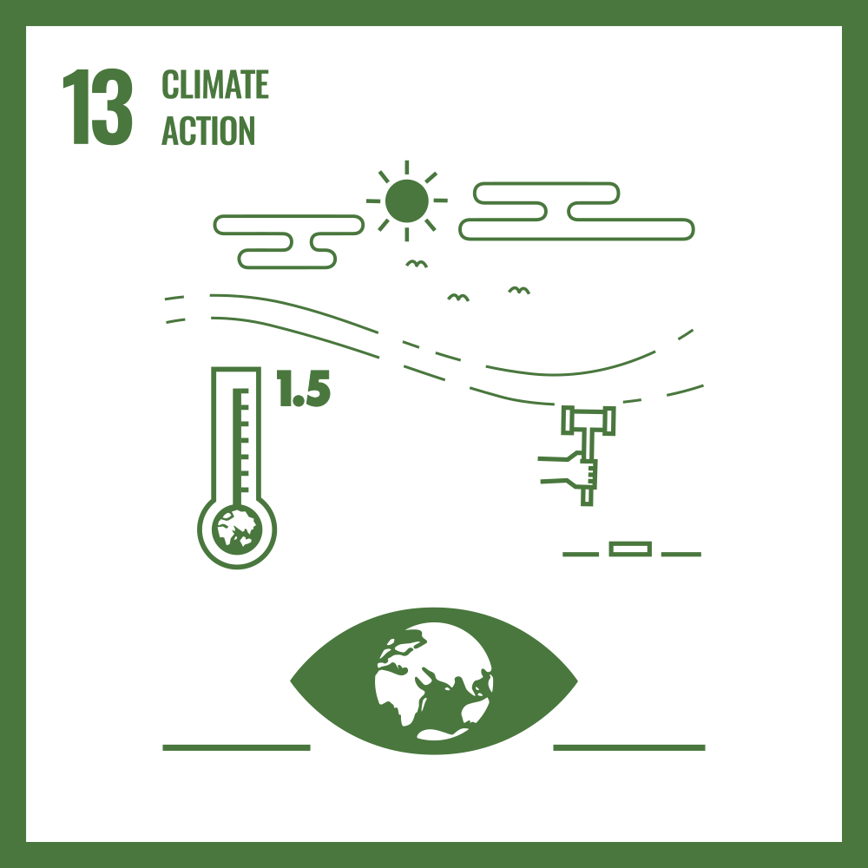
Goal 13 (Climate Action)
13.2
R.A.I.N’s energy-saving features integrate measures to reduce greenhouse gas emissions from households, contributing to climate action strategies.

Slide 26

Goal 17 (Sustainable Cities and Communities)
17.16
R.A.I.N fosters effective partnerships by involving collaboration between stakeholders for e-waste collection and reward distribution, enhancing public, public-private, and civil society partnerships.

Slide 27
Benefits and Conclusion
Environmental Impact
Cost-Effective
Reduces e-waste by repurposing components.
Minimizes the cost of new hardware.
Enhanced Home Automation
Energy Efficiency
Provides smart home features.
Optimizes energy usage.
Predictive Maintenance
Data Analytics
Extends electronics lifespan and reduces maintenance costs.
Allows homeowners to monitor energy usage and make informed decisions.
RAIN is a forward-thinking way to tackle e-waste and improve home automation in Singapore. By using discarded electronic parts, RAIN promotes sustainability and enhances living with smart home systems, as well as motivate energy saving, leading to a greener future and smarter living spaces.

